Slide 1

Predicting the cost of a plane ticket
Bianca Orozco
Notes:
My name is
California Native
Family
Holidays
Travel Site

Slide 2
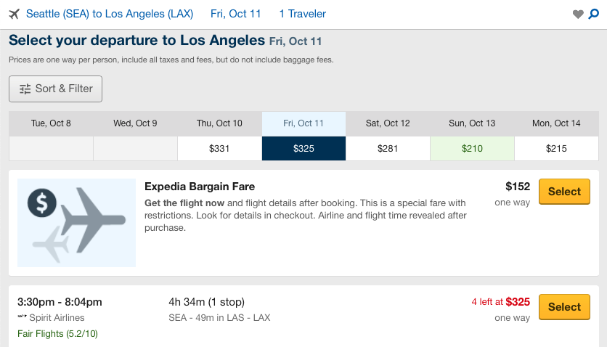
Website
Departure Airport
Arrival Airport
Flight Date
Departure Time
Arrival Time
Duration
Stops
Airline
Price
Seattle SEA
Los Angeles LAX
Fri, Oct. 11
3:30pm
8:04pm
4h 34m
1 stop
Spirit Airlines
$325
Notes:
Screenshot
Simplicity One Way for 1
Information Provided

Slide 3
Methodology
How do these features affect the price of a ticket?
Could I build a model that would predict the price?
Web Scraping with Selenium
Linear Regression modeling
Notes:
How
As a Data Scientist
Selenium
LRM
What would I be webscrabing?

Slide 4



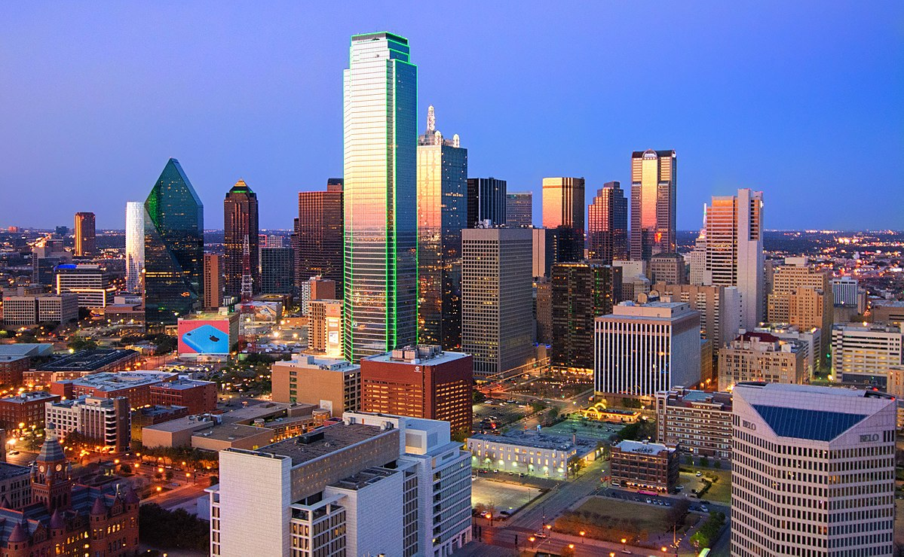
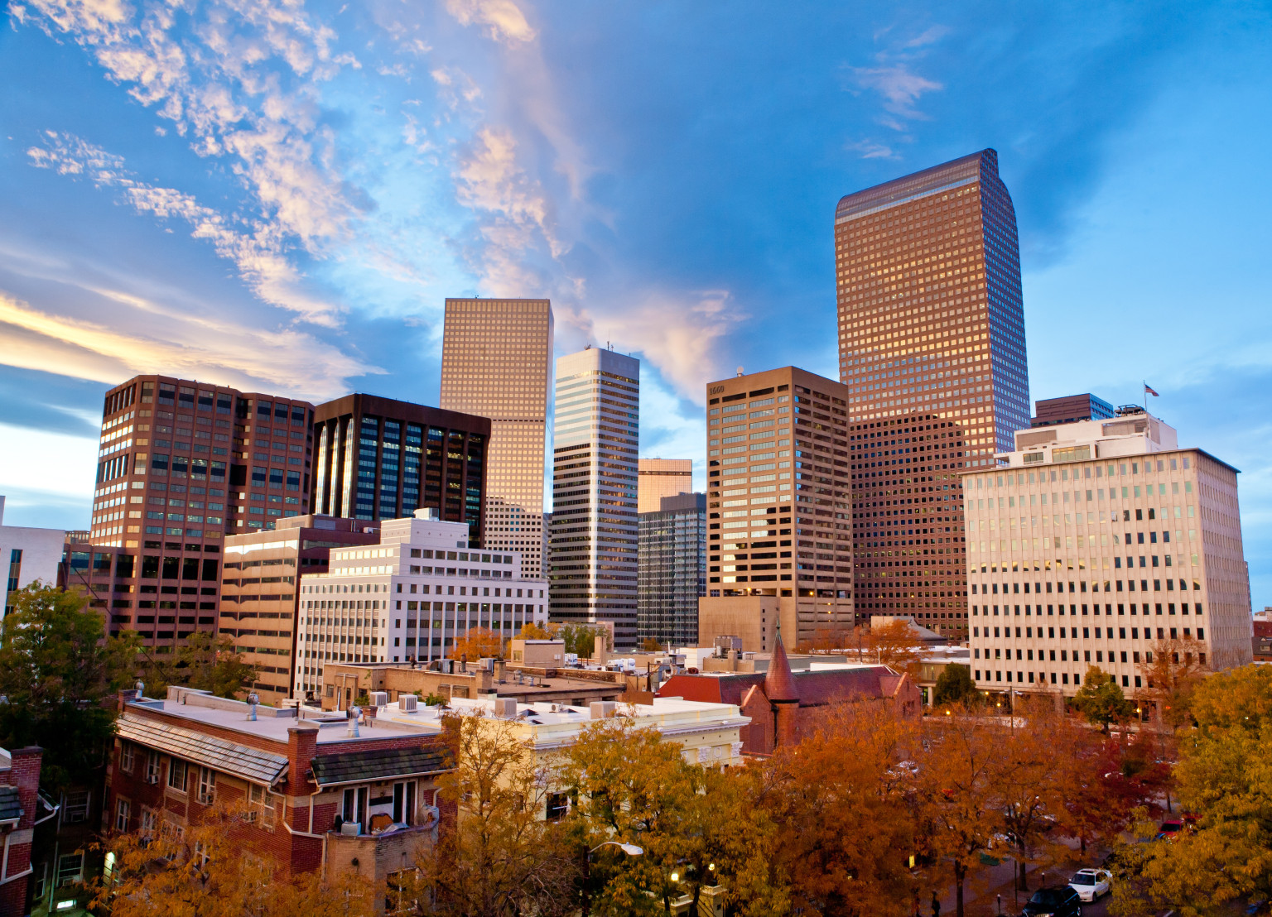

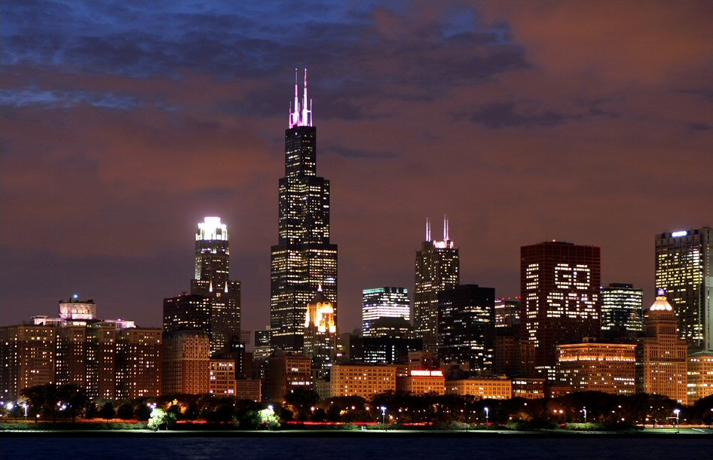

Atlanta
Los Angeles
San Francisco
Dallas
Denver
Seattle
Chicago
New York City
Notes:
Sampling Pool
Top 8 Airports in US
No Surprise Major Cities

Slide 5
Results
Models Trained:
Linear Regression
Ridge Regression
Polynomial Regression
Linear Regression:
R-Squared Value: 0.548
Notes:
After Web scraping Data
3 Different Models
Best Results
Room for improvement
What does this mean?
In terms of Prices

Slide 6
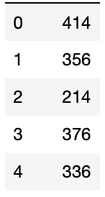
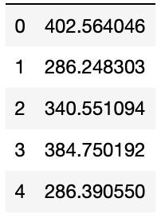
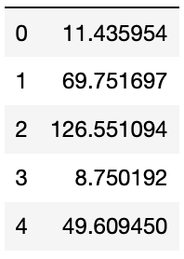
Mean Absolute Error
Absolute Value of Differences
Actual Prices
Predicted Prices
Mean Absolute Error
-
=
≈
$116
Mean: $391
Min: $88
Max: $1486

Slide 7
Future Work
Improve model
Add more features
How much do these features affect the price of a ticket?
Notes:
How
As a Data Scientist
Selenium
LRM
What would I be webscrabing?

Slide 8

Questions
Notes:
How
As a Data Scientist
Selenium
LRM
What would I be webscrabing?

